Slide 1

ORACLE DATABASE 12c
Overview
Người trình bày: Phạm Khánh Dương
Hà Nội, Ngày ..... tháng ...... năm ...........

Slide 2
Index
Introduction
Database Overview
Oracle Database 12 overview
Oracle Database 12c Integration capabilities
Oracle Database 12c Server Architecture
Memory architecture
Processes architecture
Storage architecture
Logical structure
Multitenant Container Database
Automatic Storage Management

Slide 3
Database Overview

Slide 4
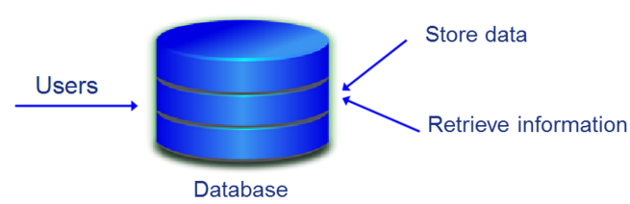
Database Introduction
Database :
Assemble structured Database
Related to each other
Allows users to store, Retrieve information, or update data

Slide 5
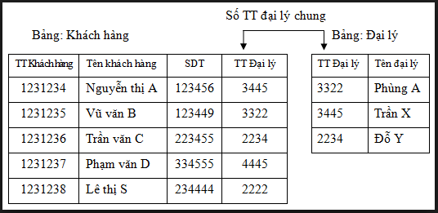
Relationship Database
Relationship Database
The data is stored in the table:
Each row is a record, also known as row
Each column is an attribute, also known as the field
Data between two table related to each other by the reference.

Slide 6
SQL
SQL (Structured Query Language)
Using to manipulate with relationship database
High level language, Ngôn ngữ bậc cao, close to human language
Example: Create table, insert, delete, update …

Slide 7
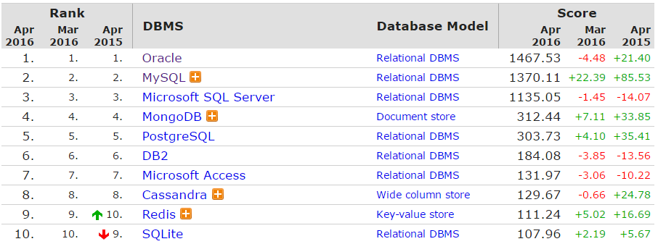
RDBMS (Relational database management system )
Relational database management system
Notes:
DB-Engines Ranking
http://db-engines.com/
The DB-Engines Ranking ranks database management systems according to their popularity. The ranking is updated monthly.
Read more about the method of calculating the scores.
Number of mentions of the system on websites, measured as number of results in search engines queries. At the moment, we use Google and Bing for this measurement. In order to count only relevant results, we are searching for <system name> together with the term database, e.g. "Oracle" and "database".
General interest in the system. For this measurement, we use the frequency of searches in Google Trends.
Frequency of technical discussions about the system. We use the number of related questions and the number of interested users on the well-known IT-related Q&A sites Stack Overflow and DBA Stack Exchange.
Number of job offers, in which the system is mentioned. We use the number of offers on the leading job search engines Indeed and Simply Hired.
Number of profiles in professional networks, in which the system is mentioned.We use the internationally most popular professional network LinkedIn.
Relevance in social networks. We count the number of Twitter tweets, in which the system is mentioned.

Slide 8
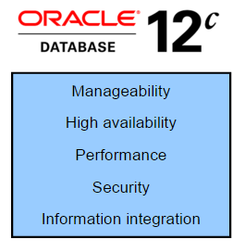
Oracle Database 12c
Notes:
Organizations need to support multiple terabytes of information for users who demand fast and secure access to business applications round the clock. The database systems must be reliable and must be able to recover quickly in the event of any kind of failure. Oracle Database 11g is designed along the following feature areas to help organizations manage infrastructure grids easily and deliver high-quality service:
Manageability: By using some of the change assurance, management automation, and fault diagnostics features, the database administrators (DBAs) can increase their productivity, reduce costs, minimize errors, and maximize quality of service. Some of the useful features that promote better management are Database Replay facility, the SQL Performance Analyzer, and the Automatic SQL Tuning facility.
High availability: By using the high availability features, you can reduce the risk of down time and data loss. These features improve online operations and enable faster database upgrades.
Performance: By using capabilities such as SecureFiles, compression for online transaction processing (OLTP), Real Application Clusters (RAC) optimizations, Result Caches, and so on, you can greatly improve the performance of your database. Oracle Database 12c enables organizations to manage large, scalable, transactional, and data warehousing systems that deliver fast data access using low-cost modular storage.
Security: Oracle Database 12c helps organizations protect their information with unique secure configurations, data encryption and masking, and sophisticated auditing capabilities. It delivers a secure and scalable platform for reliable and fast access to all types of information by using the industry-standard interfaces.
Information integration: Oracle Database 12c has many features to better integrate data throughout the enterprise. It also supports advanced information life-cycle management capabilities. This helps you manage the changing data in your database.

Slide 9

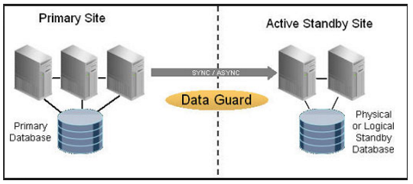
Oracle Database 12c Data Guard

Slide 10
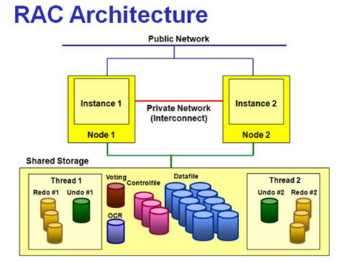
Oracle Database 12c Rac

Slide 11
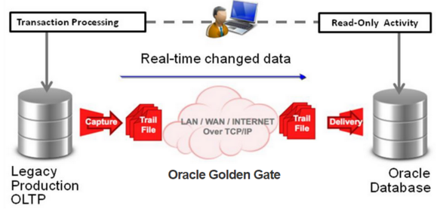
Oracle Database 12c Feature (3)

Slide 12
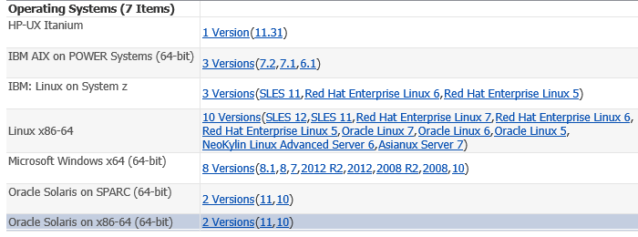
Oracle Database 12c Certifications

Slide 13
Oracle Database Server Architecture

Slide 14
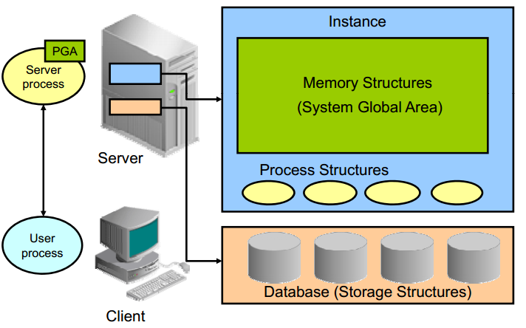
Oracle Database Server Architecture
Notes:
Oracle server :
Là tập hợp những file, những tiến trình và cấu trúc bộ nhớ
Oracle server bao gồm Oracle Instance và Oracle Database
Oracle Instance
Là tập hợp của các tiến trình ngầm (background processes) và cấu trúc bộ nhớ (memory structure). Một Instance được khởi động để truy cập dữ liệu trong Oracle Database.
Định danh bởi: Oracle System Identifier (SID)
Mỗi khi một Instance được khởi động, một System Global Area (SGA) được cấp phát và các tiến trình ngầm của Oracle cũng sẽ được khởi động. Các tiến trình ngầm này sẽ thực hiện tác vụ vào/ra và quản lý các tiến trình khác của Oracle nhằm cung cấp khả năng chạy song song để thi hành tốt hơn và tin cậy hơn:
Pmon
Smon
DBWR
LogWR
Oracle Database
Là một tập hợp các file hệ thống hay còn gọi là các file Database, cung cấp các thông tin về những thiết bị lưu trữ vật lý và thông tin và Database.
Định danh bởi: DB_NAME và DB_ID
Những file Database được sử dụng để đảm bảo rằng dữ liệu được lưu giữ ở trạng thái nhất quán, và có thể được khôi phục lại tại thời điểm một Instance bị lỗi:
Spfile : memory, vị trí control file, các setting
Control file : vị trí datafile,redo log thông tin backup, SCN
Datafile
Redolog file
Archivelog file

Slide 15
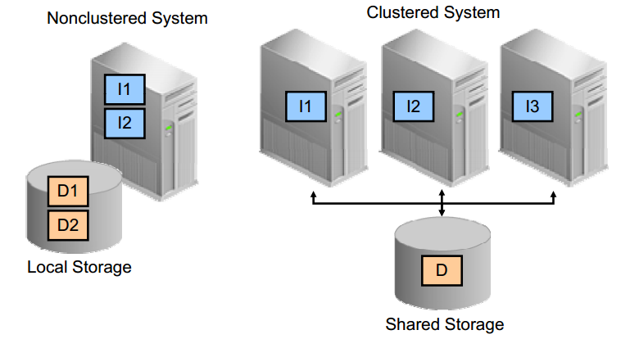
Oracle Database Instance Configurations
Notes:
Có 2 dạng cấu hình của database instance:
Single instance : 1 database – 1 instance
Rac : 1 database – n instance

Slide 16
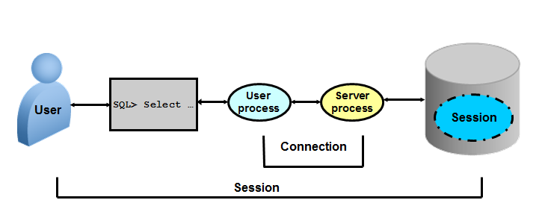
Connecting to the Database Instance
Connection: Communication between a user process and an instance
Session: Specific connection of a user to an instance through a user process

Slide 17
Memory architecture

Slide 18
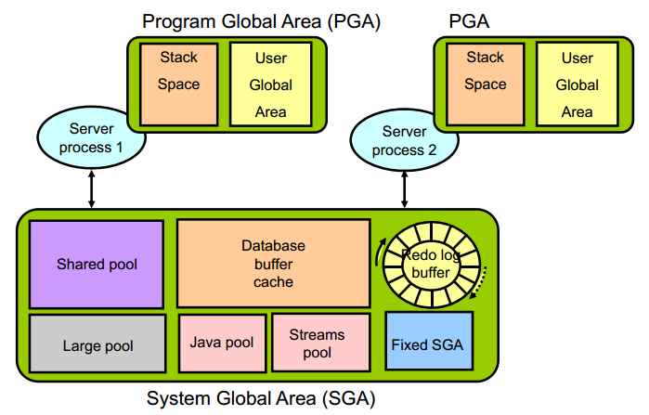
Oracle Database Memory Structures
Notes:
Có hai cấu trúc bộ nhớ cơ bản trong một Instance:
System Global Area (SGA):
Là vùng bộ nhớ chia sẻ được sử dụng để lưu trữ dữ liệu và các thông tin điều khiển của Oracle server. Được chỉ định khi một Instance được khởi động, và là thành phần cơ bản của một Oralce Instance.
The SGA được chia sẻ dung chung bởi server và các tiến trình nền processes
Program Global Area (PGA):
Là một phần cấu trúc bộ nhớ lưu trữ dành cho 1 User process kết nối tới 1 Instance bao gồm dữ liệu và thông tin điều khiển cho một Server hoặc một Background process.
Được khởi tạo Được chỉ định khi một Server Process được khởi động.

Slide 19
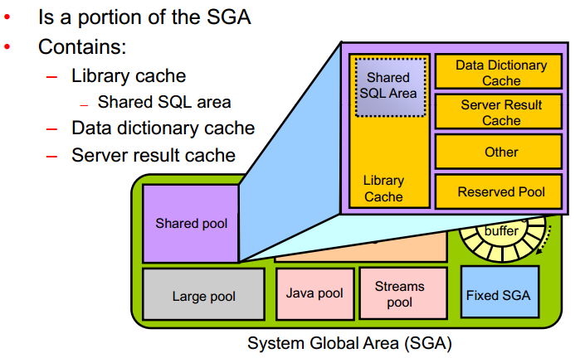
Shared pool
Notes:
Shared pool
Library cache: Lưu trữ những định nghĩa về những đoạn lệnh SQL và PL/SQL vừa được thực thi gần đây nhất theo thuật giải Least Recently Used (LRU). Library cache bao gồm 2 cấu trúc là Shared SQL area và Shared PL/SQL area. Kích thước của vùng này được xác định bởi Shared pool sizing.
Data dictionary cache: Thu thập những định nghĩa được dùng gần đây nhất trên cơ sỡ dữ liệu bao gồm các thông tin về Database file, tables, indexes, columns, user, privileges,…Trong quá trình phân tích cú pháp đoạn lệnh, Server Process sẽ đọc các thông tin định nghĩa ở Data dictionary cache để lấy tên các đối tượng, xác nhận truy cập,…Kích thước của vùng này được xác định bởi Shared pool sizing.
Shared SQL area: Oracle Database represents each SQL statement that it runs with a shared SQL area (as well as a private SQL area kept in the PGA). When a new SQL statement is parsed, Oracle Database allocates memory from the shared pool to store in the shared SQL area. The size of this memory depends on the complexity of the statement
The server result cache contains the SQL query result cache and PL/SQL function result cache, which share the same infrastructure. The server result cache contains result sets, not data blocks
The reserved pool is a memory area in the shared pool that Oracle Database can use to allocate large contiguous chunks of memory

Slide 20
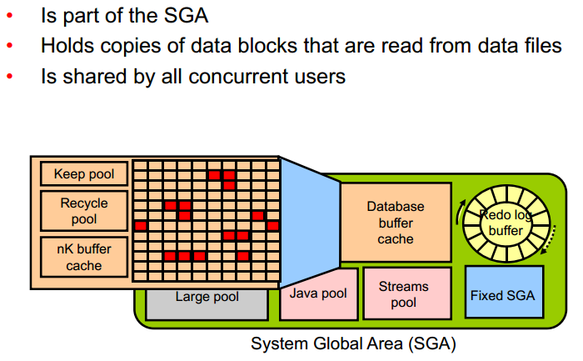
Database Buffer Cache
Notes:
Lưu trữ những bản copy của Block dữ liệu đã được đọc từ Data File. Khi một đoạn SQL được thực thi, thì Server Process sẽ đọc các thông tin từ Database buffer cache để lấy các block dữ liệu cần thiết, điều này giúp cho tốc độ hoạt động của hệ thống sẽ cao hơn vì đọc trên cache sẽ nhanh hơn là đọc trên đĩa cứng . Nếu các block dữ liệu không có trong Database buffer cache thì Server process mới đọc dữ liệu từ data file. Database buffer cache cũng sử dụng thuật giải LRU như ở Shared Pool.
The keep buffer pool and the recycle buffer pool are used for specialized buffer pool tuning. The keep buffer pool is designed to retain buffers in memory longer than the LRU would normally retain them. The recycle buffer pool is designed to flush buffers from memory faster than the LRU normally would.
nK buffer caches, additional buffer can be configured to hold blocks of a size that is different from the default block size.

Slide 21
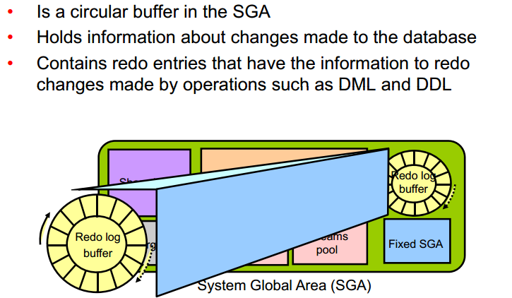
Redo Log Buffer
Notes:
Redo entries contain the information necessary to reconstruct (or redo) changes that are made to the database by DML, DDL, or internal operations. Redo entries are used for database recovery if necessary

Slide 22
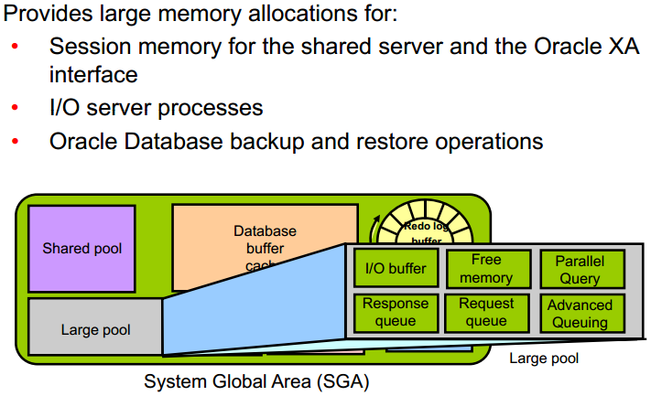
Large pool
Notes:
The database administrator can configure an optional memory area called the large pool to provide large memory allocations for:
Session memory for the shared server and the Oracle XA interface (used where transactions interact with multiple databases)
I/O server processes
Oracle Database backup and restore operations
Parallel Query operations
Advanced Queuing memory table storage

Slide 23
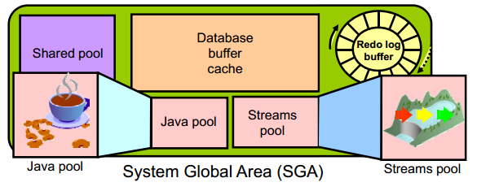
Java pool & Streams pool
Notes:
Java pool memory is used to store all session-specific Java code and data in the Java Virtual Machine (JVM). Java pool memory is used in different ways, depending on the mode in which Oracle Database is running.
The Streams pool is used exclusively by Oracle Streams. The Streams pool stores buffered queue messages, and it provides memory for Oracle Streams capture processes and apply processes. Unless you specifically configure it, the size of the Streams pool starts at zero. The pool size grows dynamically as needed when Oracle Streams is used.

Slide 24
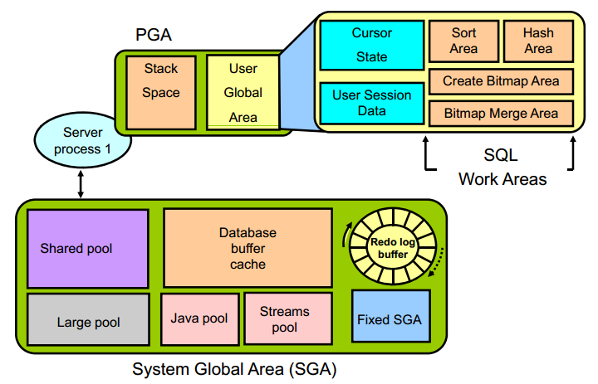
Program Global Area (PGA)
Notes:
Program Global Area (PGA) là vùng nhớ riêng bao gồm dữ liệu và thông tin điều khiển của một Server Process. Mỗi Server Process đều có một PGA riêng biệt. PGA bao gồm:
Stack space : lưu trữ các biến và các mảng được xử lý trên PGA
User Global Area (UGA):
Cursor State : lưu trữ thông tin con trỏ
User session data : Lưu trữ thông tin điều khiển của 1 session
SQL working Areas : thực thi các câu lệnh truy vấn SQL :
Hash area: kết nối giữa các bảng bằng hash
Create bitmap area: sử dụng để tạo index bitmap
Bitmap merge area: sử dụng để tạo các kế hoạch cho index bitmap
Sort area: sử dụng cho các hàm gom nhóm dữ liệu như: ORDER BY and GROUP BY

Slide 25
Processes architecture

Slide 26
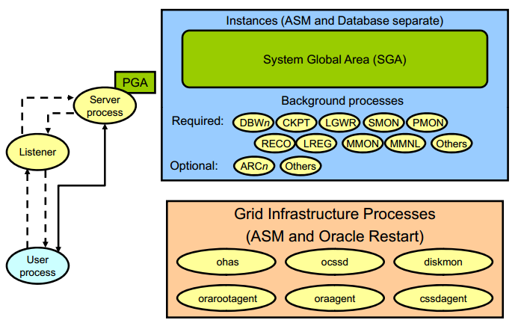
Process Architecture
User process
Is the application or tool that connects to the Oracle database
Database processes
Server process: Connects to the Oracle instance and is started when a user establishes a session
Background processes: Are started when an Oracle instance is started
Daemon / Application processes
Networking listeners
Grid Infrastructure daemons
Notes:
The processes in an Oracle Database system can be divided into three major groups:
User processes that run the application or Oracle tool code
Oracle Database processes that run the Oracle Database server code (including server processes and background processes)
Server processes created on behalf of each user’s application can perform one or more of the following:
Parse and run SQL statements issued through the application.
Read necessary data blocks from data files on disk into the shared database buffers of the SGA (if the blocks are not already present in the SGA).
Return results in such a way that the application can process the information
To maximize performance and accommodate many users, a multiprocess Oracle Database system uses some additional Oracle Database processes called background processes. An Oracle Database instance can have many background processes.
Oracle daemons and application processes not specific to a single database
Networking listeners
Grid Infrastructure daemons

Slide 27
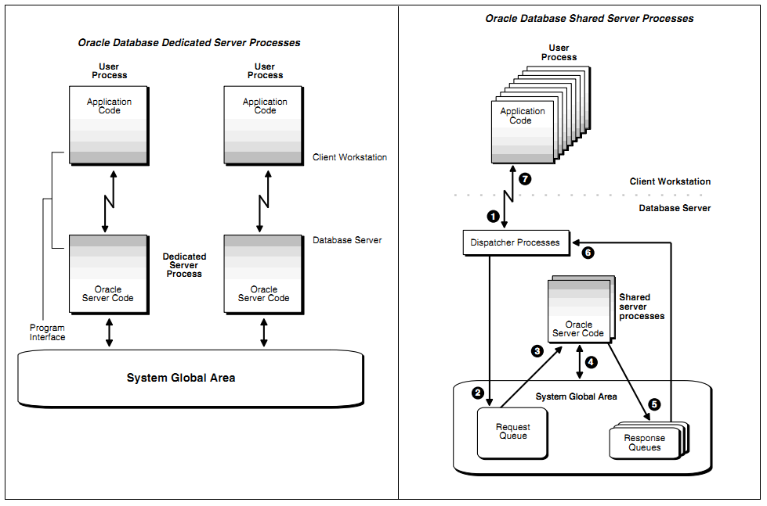
Server Process
Notes:
Dedicated Server Processes
Khái niệm:
Dedicated server process: một server process chỉ phục vụ một user process
Sử dụng khi:
Thực thi các job lớn ( các job rất ít, hoặc không có thời gian chờ đợi...)
Sử dụng (RMAN) để back up, restore, hoặc recover database
Shared Server Processes
Khái niệm:
Shared server process: một server process có thê phục vụ nhiều user process
Sử dụng 1 bộ điều phối để quản lý tài nguyên ( DISPATCHERS )
Sử dụng khi:
Có rất nhiều user process kết nối tới DB và các server này tương tự nhau và có thể chờ đợi được ( đăng kí vé ....)

Slide 28
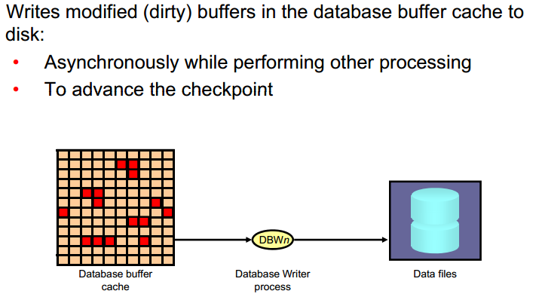
Database Writer (DBWn)
Notes:
The Database Writer process (DBWn) writes the contents of buffers to data files.
The DBWn processes are responsible for writing modified (dirty) buffers in the database buffer cache to disk.
The DB_WRITER_PROCESSES initialization parameter specifies the number of DBWn processes. The maximum number of Database Writer processes is 100. If it is not specified by the user during startup, Oracle Database determines how to set DB_WRITER_PROCESSES based on the number of CPUs and processor groups.
The DBWn process writes dirty buffers to disk under the following conditions:
When a server process cannot find a clean reusable buffer after scanning a threshold
number of buffers, it signals DBWn to write. DBWn writes dirty buffers to disk asynchronously while performing other processing.
DBWn writesbuffers to advance the checkpoint, which is the position in the redo thread (log) from which instance recovery begins. This log position is determined by the oldest dirty buffer in the buffer cache.
In all cases, DBWn performs batched (multiblock) writes to improve efficiency. The number of blocks written in a multiblock write varies by operating system

Slide 29
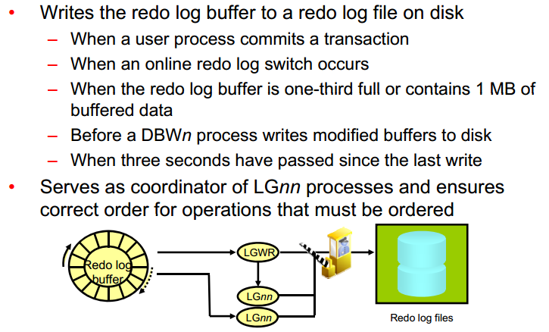
Log Writer Process (LGWR)
Notes:
The Log Writer process (LGWR) is responsible for redo log buffer management by writing the redo log buffer entries to a redo log file on disk. LGWR writes all redo entries that have been copied into the buffer since the last time it wrote.
LGWR starts and coordinates multiple helper processes that concurrently perform some of the work. LGWR handles the operations that are very fast, or must be coordinated, and delegates operations to the LGnn that could benefit from concurrent operations, primarily writing the redo from the log buffer to the redo log file and posting the completed write to the foreground process that is waiting.
Writes the redo log buffer to a redo log file on disk
When a user process commits a transaction
When an online redo log switch occurs
When the redo log buffer is one-third full or contains 1 MB of buffered data
Before a DBWn process writes modified buffers to disk
When three seconds have passed since the last write
Serves as coordinator of LGnn processes and ensures correct order for operations that must be ordered

Slide 30
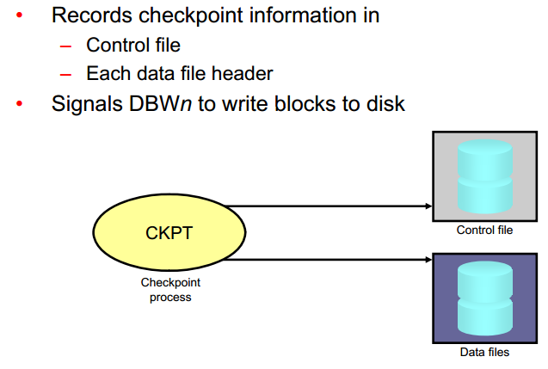
Checkpoint Process (CKPT)
Notes:
A checkpoint is a data structure that defines a system change number (SCN) in the redo thread of a database. Checkpoints are recorded in the control file and in each data file header. They are a crucial element of recovery.
When a checkpoint occurs, Oracle Database must update the headers of all data files to record the details of the checkpoint. This is done by the CKPT process. And Signals DBWn to write blocks to disk

Slide 31
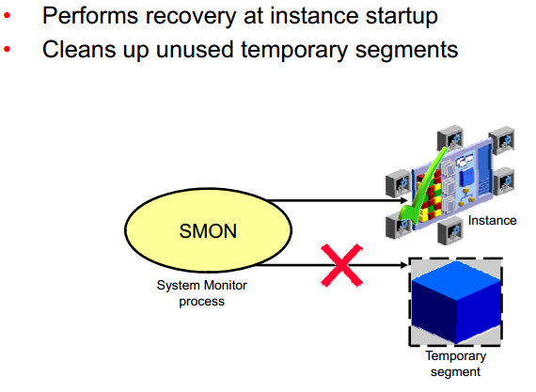
System Monitor Process (SMON)
Notes:
The System Monitor process (SMON) performs recovery at instance startup if necessary. SMON is also responsible for cleaning up temporary segments that are no longer in use. If any terminated transactions were skipped during instance recovery because of file-read or offline errors, SMON recovers them when the tablespace or file is brought back online

Slide 32
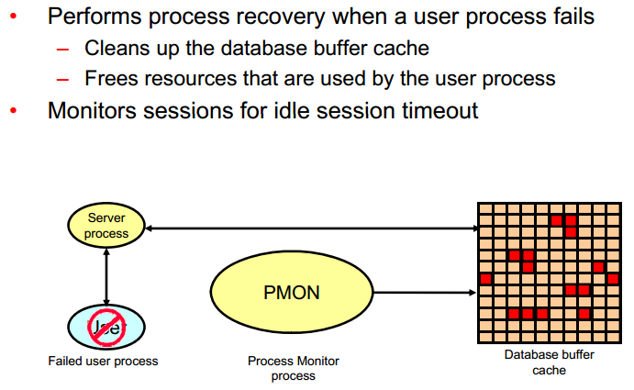
Notes:
The Process Monitor process (PMON) performs process recovery when a user process fails. PMON is responsible for cleaning up the database buffer cache and freeing resources that the user process was using
PMON periodically checks the status of dispatcher and server processes, and restarts any that have stopped running (but not any that Oracle Database has terminated intentionally).

Slide 33
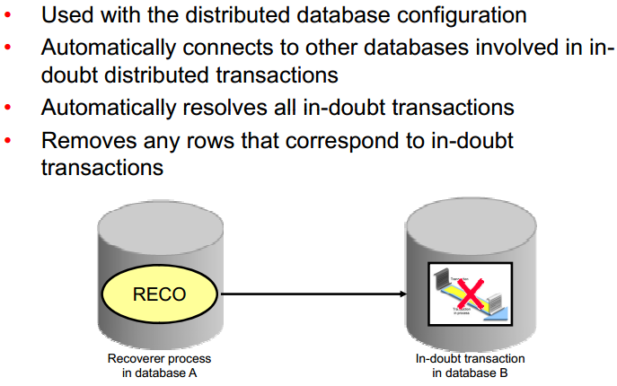
Recoverer Process (RECO)
Notes:
The Recoverer process (RECO) is a background process that is used with the distribute database configuration that automatically resolves failures involving distributed transactions
Automatically connects to other databases involved in indoubt distributed transactions
Automatically resolves all in-doubt transactions
Removes any rows that correspond to in-doubt transactions

Slide 34
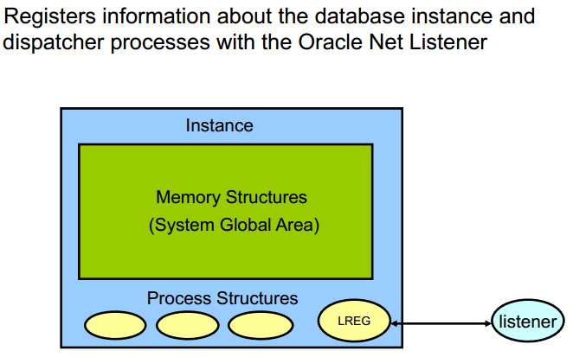
Listener Registration Process (LREG)
Notes:
The Listener Registration process, LREG, registers information about the database instance and dispatcher processes with the Oracle Net Listener. LREG provides the listener with the following information:
Names of the database services
Name of the database instance associated with the services and its current and maximum load
Service handlers available for the instance, including their type, protocol addresses, and current and maximum load

Slide 35
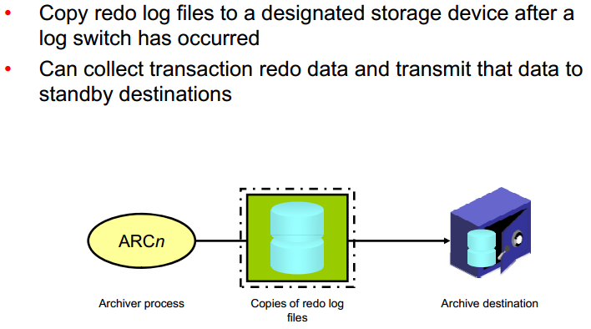
Archiver Processes (ARCn)

Slide 36
Storage architecture

Slide 37
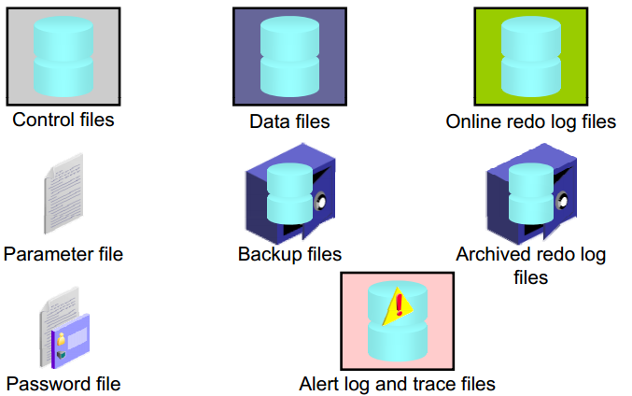
Storage architecture

Slide 38
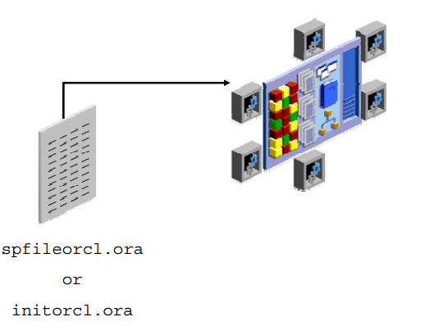
Parameter file
Notes:
Parameter file
File chứa những thông tin cấu hình của 1 instance và địa chỉ của controlfile.
Ví dụ như: Các vùng nhớ khởi tạo được cấp phát bao nhiêu GB, các control_file nằm ở đâu, bao nhiêu process, session v.v…
Parameter có 2 loại là SPFile (file Binary) và Pfile (file text), nhiệm vụ của 2 file này là giống nhau. Mặc định, lúc khởi động DB, Oracle sẽ ưu tiên sử dụng spfile trước, nếu không có thì sẽ chuyển sang dùng pfile ( pfile có thể lưu trữ địa chỉ của spfile)
When you start the instance, an initialization parameter file is read. There are two types of parameter files.
Server parameter file (SPFILE): This is the preferred type of initialization parameter file. It is a binary file that can be written to and read by the database server and must not be edited manually. It resides on the server on which the Oracle instance is executing; it is persistent across shutdown and startup. The default name of this file, which is automatically sought at startup, is spfile<SID>.ora.
Text initialization parameter file: This type of initialization parameter file can be read by the database server, but it is not written to by the server. The initialization parameter settings must be set and changed manually by using a text editor so that they are persistent across shutdown and startup. The default name of this file (which is automatically sought at startup if an SPFILE is not found) is init<SID>.ora.
In the majority of cases, it is necessary to set and tune only the 30 or so basic parameters to get reasonable performance from the database. In rare situations, modification of the advanced parameters may be needed to achieve optimal performance. There are more than 300 advanced parameters.

Slide 39
Control files
At least one control file in a database ( recommend 2 )
Critical to the database. Without the control file, the database cannot be opened
Contains information items specified physical structure of the database, such as:
The name of the database.
Names and places to store datafiles, redo log files.
The information on the database backup
Also used to performing data restore.

Slide 40
Datafiles
One or more datafiles in a database .
Store logical objects of the database, such as tables or view, indexes…
Some characteristics of datafiles:
Each datafile can only be used in a database.
Can be allowed automatically extend when necessary.
One or more datafiles form a logical unit of database storage called a tablespace. A datafile only belong to one table space.

Slide 41
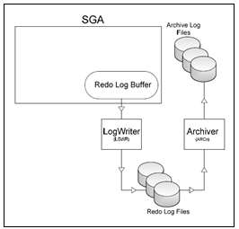
Redo Log Files - Archivelog
Notes:
REDO LOG file là một phần quan trọng của quá trình Oracle recovery. Được sử dụng để recover database khi bị crash.
Chức năng chính của redo log là ghi lại tất cả các thay đổi đối với dữ liệu trong database. Redo log files được sử dụng để bảo vệ database khỏi những sự cố. Oracle cho phép sử dụng cùng một lúc nhiều redo log gọi là multiplexed redo log để cùng lưu trữ các bản sao của redo log trên các ổ đĩa khác nhau
Khi mỗi Oracle block thay đổi, Oracle tạo ra các vector thay đổi cho nó. Mỗi vetor này được cọi là REDO entry hoặc REDO records. Những sự thay đổi này sẽ được server process ghi vào redo log buffer trên PGA. Redo log buffer ghi xuống online redo log vào 1 thời điểm nào đó bởi LGWR
Redolog thường gồm ít nhất 2 đơn vị, ghi lại những thao tác tác động lên DB, khi 1 redolog đầy sẽ switch sang redo log bên cạnh. Khi switch sang 1 redolog đã có dữ liệu, dữ liệu này sẽ được ghi xuống archivelog để lưu trữ
Archived redo log files:
Contain an ongoing history of the data changes (redo) that are generated by the instance. Using these files and a backup of the database, you can recover a lost data file. That is, archive logs enable the recovery of restored data files.

Slide 42
Other important file
Password file:
Allows users using the SYSDBA, SYSOPER, SYSBACKUP, SYSDG, SYSKM, and SYSASM roles to connect remotely to the instance and perform administrative tasks
Backup files :
Are use for database recovery. You typically restore a backup file when a media failure or user error has damaged or deleted the original file
Alert log file:
The alert log of a database is a chronological log of messages and errors. Oracle recommends that you review the alert log periodically.

Slide 43
Logical structure

Slide 44
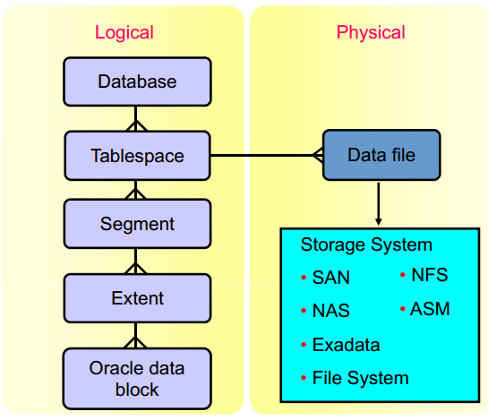
Logical and Physical Database Structures

Slide 45
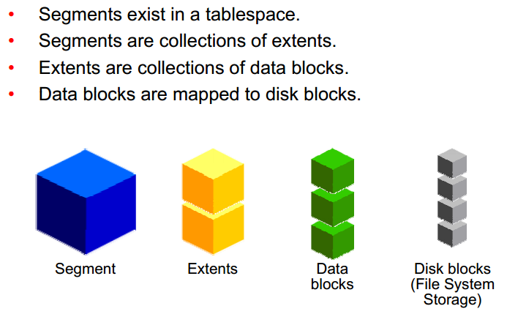
Segments, Extents, and Blocks
Notes:
At the finest level of granularity, Oracle stores data in data blocks (also called logical blocks, Oracle blocks, or pages). One data block corresponds to a specific number of bytes of physical database space on disk.
The next level of logical database space is an extent. An extent is a specific number of contiguous data blocks allocated for storing a specific type of information.
Segments
The level of logical database storage above an extent is called a segment. A segment is a set of extents allocated for a certain logical structure. Example:
Data segments: Each nonclustered, non-index-organized table has a data segment, with the exception of external tables, global temporary tables, and partitioned tables (in which each table has one or more segments). All of the table’s data is stored in the extents of its data segment. For a partitioned table, each partition has a data segment. Each cluster has a data segment. The data of every table in the cluster is stored in the cluster’s data segment.
Index segments: Each index has an index segment that stores all of its data. For a partitioned index, each partition has an index segment.
Undo segments: One UNDO tablespace is created for each database instance This tablespace contains numerous undo segments to temporarily store undo information. The information in an undo segment is used to generate read-consistent database information and, during database recovery, to roll back uncommitted transactions for users.
Temporary segments: Temporary segments are created by the Oracle database when a SQL statement needs a temporary work area to complete execution. When the statement finishes execution, the temporary segment’s extents are returned to the database for future use. Specify either a default temporary tablespace for every user, or a default temporary tablespace that is used database-wide

Slide 46
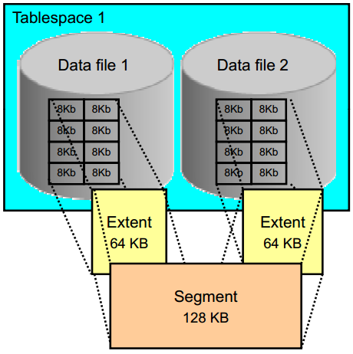
Tablespaces and Data Files

Slide 47
Tablespaces
Include of a group of components (logic) the logical relationship to each other.
Each table space can be created, by one or more datafiles.
Type:
SYSTEM, SYSAUX( auxiliary to system)
Non – System
Notes:
The size of the database can also be determined by the total size of its tablespaces
Phân loại:
Tablespace SYSTEM
Sẽ tự động được tạo khi database tạo.
Có trong tất cả các database dùng cho hoạt động của database
Chứa thông tin về các data dictionary view,các định nghĩa của store procedure,pakage và các database trigger.
Chứa SYSTEM Undo segment.
Chứa SYSTEM rollback segment
Non – System Tablespace
Có thể lưu trữ rollback segment, temporary segment, data segment, index segment
Giúp cho quản trị database linh hoạt hơn.

Slide 48
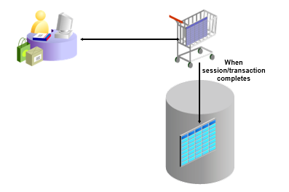
Temporary tablespace & tempory table
Notes:
Temporary tablespace
Tempory Tablespace được sử dụng để chứa các tempory table trong thời gian của các phiên giao dịch.
Temporary tablespaces sử dụng lưu trữ:
Intermediate sort results: nếu dữ liệu truy vấn trong PGA quá nhiều thì nó có thể được lưu trữ tại đây và lấy dần ra
Temporary tables and temporary indexes
Temporary LOBs
Temporary B-trees
Mặc định, chỉ có Temp tablespace duy nhất được tạo ra khi cài đặt một Oracle mới. Nhưng có thể tạo thêm tablespace bổ sung
Temporary table
Temporary Table là một bảng chứa dữ liệu mà chỉ tồn tại trong thời gian của một giao dịch hoặc phiên . Dữ liệu trong một bảng tạm thời là trong phiên giao dịch, có nghĩa là mỗi phiên chỉ có thể xem và sửa đổi dữ liệu riêng của mình .
Temporary table rất hữu ích trong các ứng dụng một tập hợp kết quả được đếm.
Ví dụ : một giỏ mua hàng trong một ứng dụng trực tuyến có thể là một bảng tạm thời. Mỗi mục được đại diện bởi một hàng trong bảng tạm thời. Bởi vì bảng tạm thời được định nghĩa cố định , nên có thể tạo index cho Chỉ số tạo ra trên bảng tạm thời cũng chỉ là tạm thời . Các dữ liệu trong các chỉ số có cùng một phiên , phạm vi giao dịch như các dữ liệu trong bảng tạm thời .

Slide 49
Multitenant
Container Database

Slide 50
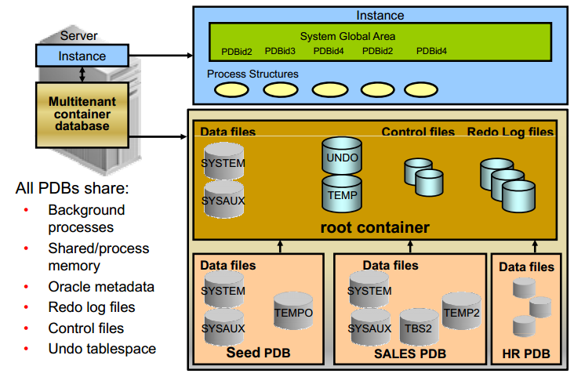
Multitenant Architecture
Notes:
At the physical level, the CDB has a database instance and database files, just as a non-CDB does.
The redo log files are common for the whole CDB. The information it contains is annotated with the identity of the PDB where a change occurs. Oracle GoldenGate is enhanced to understand the format of the redo log for a CDB. All PDBs in a CDB share the ARCHIVELOG mode of the CDB.
The control files are common for the whole CDB. The control files are updated to reflect any additional tablespace and data files of plugged PDBs.
The UNDO tablespace is common for all containers.
A temporary tablespace common to all containers is required. But each PDB can hold its own temporary tablespace for its own local users.
Each container has its own data dictionary stored in its proper SYSTEM tablespace, containing its own metadata, and a SYSAUX tablespace.
Th PDBs can create tablespaces within the PDB according to application needs.
Each data file is associated with a specific container, named CON_ID.

Slide 51
Automatic Storage
Management

Slide 52
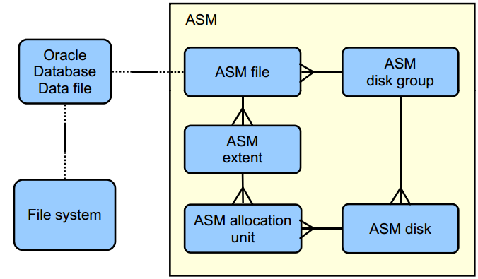
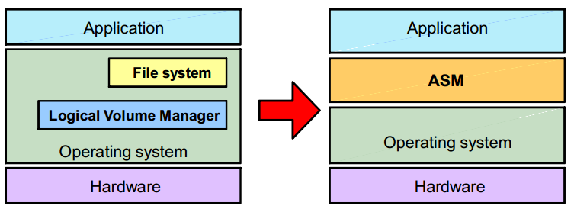
Introduction: Oracle ASM
Notes:
Oracle ASM is a volume manager and a file system for Oracle Database files that supports single-instance Oracle Database and Oracle Real Application Clusters (Oracle RAC) configurations. Oracle ASM is Oracle's recommended storage management solution that provides an alternative to conventional volume managers, file systems, and raw devices.. Combining volume management functions with a file system allows a level of integration and efficiency that would not otherwise be possible. For example, ASM is able to avoid the overhead associated with a conventional file system and achieve native raw disk performance for Oracle data files and other file types supported by ASM. ASM is engineered to operate efficiently in both clustered and nonclustered environments. Oracle ASM files can coexist with other storage management options such as raw disks and third-party file systems. This capability simplifies the integration of Oracle ASM into pre existing environments.
Is a portable and high-performance cluster file system
Manages Oracle database files
Manages application files with ASM Cluster File System (ACFS)
Spreads data across disks to balance load
Mirrors data in case of failures
Solves storage management challenges

Slide 53
ASM Features and Benefits
Stripes files rather than logical volumes
Provides redundancy on a file basis
Enables online disk reconfiguration and dynamic rebalancing
Reduces the time significantly to resynchronize a transient failure by tracking changes while the disk is offline
Provides adjustable rebalancing speed
Is cluster-aware
Supports reading from mirrored copy instead of primary copy for extended clusters

Slide 54
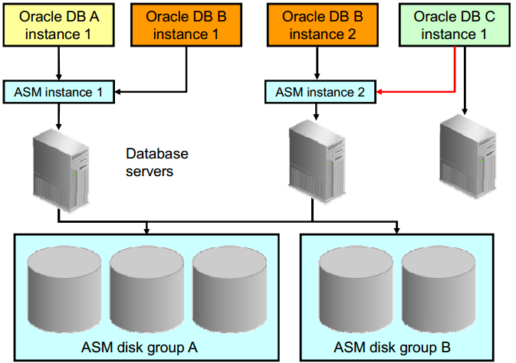
ASM Instance Designs

Slide 55
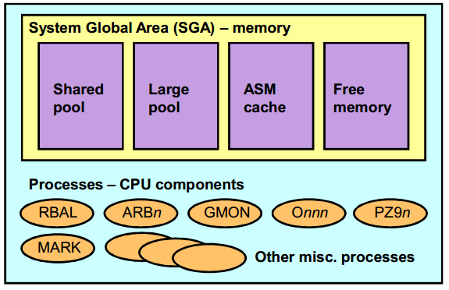
ASM Instance
Notes:
• Shared Pool: Used for metadata information • Large Pool: Used for parallel operations • ASM Cache: Used for reading and writing blocks during rebalance operations • Free Memory: Unallocated memory available
• ARCn: The archiver processes (Exists only when the database is in ARCHIVELOG mode and automatic archiving is enabled) • CKPT: The checkpoint process • DBWn: The database writer processes • DIAG: The diagnosability process • CJQ0: The job coordinator process (Started and stopped as needed by Oracle Scheduler, dynamically spawns job queue slave processes (Jnnn) to run the jobs) • Jnnn: Job queue processes • LGWR: The log writer process • PMON: The process monitor process • PSP0: The process spawner process • QMNn: The queue monitor processes (If AQ_TM_PROCESSES is 0, this process will not start) • SMON: The system monitor process • VKTM: The virtual keeper of time process • MMAN: The memory manager process

Slide 56
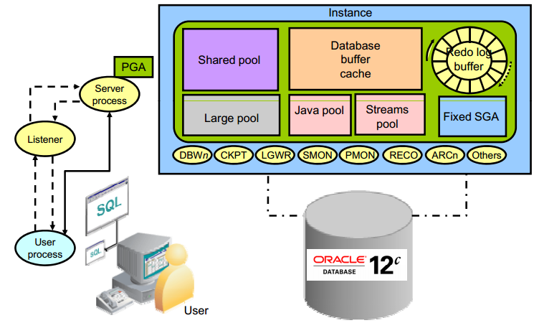
Summary
List the major architectural components of Oracle Database
Explain memory structures
Describe background processes
Correlate logical and physical storage structures
Describe pluggable databases
Describe ASM storage components

Slide 57

Questions and Answers

